Slide 1
Meeting the expectations of home-buyers
Notes:
My name is Stacey and I will be talking through the business benefits for you of including energy usage dashboards in the homes you are building.

Slide 2
Agenda
Objective
The financial returns & the market
What home-buyers say
Your competitors
How we will help you
What the sub-meters can tell your home buyers
Ways to make your smart home even more attractive to home-buyers
Notes:
I will begin by looking at the market and what homebuyers say they will pay more for. I will then show you what information could be included in a dashboard using the data that you gave us. I will finish by looking at areas for further investigation and our next steps.

Slide 3
The objective
Produce highly efficient Smart Homes with the energy usage information that home-buyers expect as standard.
Notes:
Starting with the objective of this project. The aim is to produce highly efficient Smart Homes with the energy usage information that home buyers expect as standard.

Slide 4
The financial returns
Providing buyers with long-term benefits enables a developer to add a premium to the purchase price in exchange for future savings.
Notes:
Buyers will pay more for a home that can monitor their energy usage. You can add a premium to the purchase price and, in return, the homebuyer makes savings on their energy bills in the future.

Slide 5
The market
Those who have grown up in a connected world are starting to purchase homes. They understand the long-term benefits of a smart home for saving energy costs.
Home value increases in terms of appeal. Smart devices are becoming expected and necessary when it comes to purchasing a home.
Notes:
Perhaps most important is the fact that buyers don’t see smart devices as added extras. Buyers who have grown up in a connected world are starting to purchase homes. They understand the long-term benefits of a connected home for saving energy costs.
While smart devices increase the appeal of a home, they are in fact becoming expected and necessary.

Slide 6
What home buyers say
Research by Loxone (2016), Barclays Digital Homes Report (2015), Honeywell (2014)
https://www.loxone.com/enen/business-partners/property-developers/
66%
28%
47%
Want a professional system
Will spend €10,000 extra
Want a smart home
Control everything from a single app
No DIY
For a property with the latest home technology
Source: Research by Loxone (2016), Barclays Digital Homes Report (2015), Honeywell (2014) https://www.loxone.com/enen/busiess-partners/property-developers
Notes:
Research shows that almost half of home buyers want a smart home. Two-thirds want a professional system and not any DIY. And over a quarter will pay €10,000 extra for the latest home technology.
As you can see, the market is demanding smart devices and there is a financial advantage for you if you include energy usage dashboards in the homes you are building.

Slide 7
Your competitors building smart homes
Apple is working with homebuilders to make smart houses in Milton Keynes, UK.
Notes:
It is clear why many of your competitors are building smart homes and Apple is working with homebuilders in the UK to make smart homes.

Slide 8
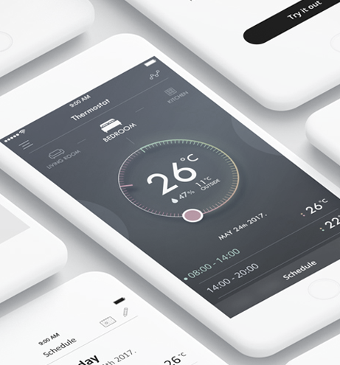
How we will help you to deliver what buyers want
Develop analytics for sub-metering devices
Create useful and easy-to-understand analytics and visualisations
Notes:
Let’s now look at how we can help you to deliver what buyers want.
We will develop analytics for measuring energy usage in sub-metering devices and create useful and easy-to-understand analytics and visualisations for your homebuyers.

Slide 9
What the sub-meters can tell your home buyers
Notes:
To demonstrate what we can do for you, we have analysed the four-years of energy data that you gave us and created a mock-up of the energy usage dashboard.

Slide 10
Water, heating and air-conditioning use the most energy
Laundry room 2,108 kW/Hr
Rest of the house
1,4811 kW/Hr
Water & heat 9,759 kW/Hr
Kitchen
1,820 kW/Hr
Notes:
It will come as no surprise that water, heating and air-conditioning use the most energy. But our analytics can go much deeper than just top-level information like this.

Slide 11
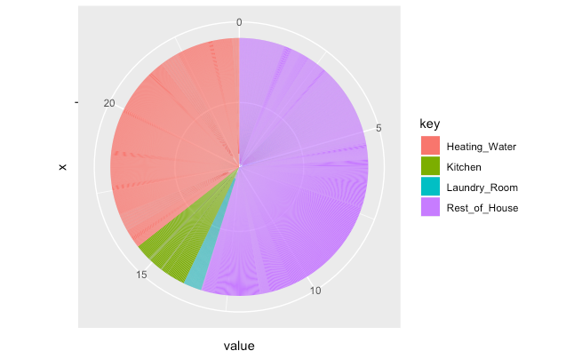
Overview
Kitchen
Laundry room
Water/Heating
Rest of house
1-14 Sept
Today
Compared to yesterday
47.29€
Compared to last month
Jan-Aug
892.54€
Compared to last year
3.68€
Notes:
Here is a mock up of what the screen could look like. The home page gives an overview of the day in question, in this case 15 September 2009, and says how much energy has cost and where usage has been in the house. It puts the day in some context by also showing the days in September leading up to 15 September and the year so far. The red arrows show the usage compared to the day, month and year before.

Slide 12
Overview
Kitchen
Laundry room
Water/Heating
Rest of house
1-14 Sept
Today
Compared to yesterday
Compared to last month
Jan-Aug
Compared to last year
Notes:
It is then possible to click on a particular area and see the usage of a particular meter. Here we have the water/heating usage covering the same day.

Slide 13
Selling points for your home-buyers
Control and save money
Predict usage for better budget
Notes:
Your selling point to homebuyers is that they can very easily see where they are using most energy and this gives them more control and the opportunity to save money.
The data you gave us could also be used to predict usage in the future and in this way your homebuyers can budget better.

Slide 14
Additional sub-meters that would add other useful information
Individual appliances
Lighting
Gas
Water
Notes:
Having looked at the information you gave us, I have some thoughts on where it would be useful to include additional submeters - for individual appliances, lighting, gas and water.
The more control you offer, the more attractive your homes will be to buyers.

Slide 15
Summary
The market demands smart devices and energy usage monitoring.
Your competitors have already tested the market and we can learn from their experiences.
The suggested sub-meters offer useful information but additional sub-meters would make your offering even more attractive to homebuyers.

Slide 16
Next steps
Further exploration of the data
Deal with missing days in the data
Develop the dashboard
Notes:
Missing days – faulty sensors or lost signal but can make predictions based on comparable days in the data

Slide 17
Thank you
Stacey Jackson

Slide 18
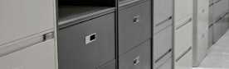
Appendix

Slide 19
Sub-meter 1: quarterly readings for each year

Slide 20
Sub-meter 1: monthly readings over the four years

Slide 21
Sub-meter 2: quarterly readings for each year

Slide 22
Sub-meter 2: monthly readings over the four years

Slide 23
Sub-meter 3: quarterly readings for each year

Slide 24
Sub-meter 3: monthly readings over the four years

Slide 25
Sub-meter 4: quarterly readings for each year

Slide 26
Sub-meter 4: monthly readings over the four years

